Slide 1
Civil Disobedience

Slide 2
Three Principles of Civil Disobedience
Maintain respect for the rule of law even while disobeying the specific law that you perceive as unjust.
Plead guilty to any violation of the law
Attempt to convert your opponent by demonstrating the justice of your cause

Slide 3
Civil Disobedience Movements in History
Henry David Thoreau (1817 – 1862)
Resistance to Civil Government (Civil Disobedience) in 1849
M.K. Gandhi (1869-1947)
Salt March in 1930
Martin Luther King Jr. (1929 – 1968)
America’s Civil Rights Movement (1964)
Nelson Mandela (1918-2013)
End of Apartheid in South Africa

Slide 4
Thoreau and Gandhi
Thoreau's metaphor comparing the government to a machine: when the machine was producing injustice, it was the duty of conscientious citizens to be "a counter friction" (i.e., a resistance) "to stop the machine.“
Mahatma Gandhi used this interpretation to suggest an equivalence between Thoreau's civil disobedience and his own satyagraha.^{[3]}

Slide 5
A strong sense of individualism and skepticism toward government
"Must the citizen ever for a moment, or in the least degree, resign his conscience to the legislator? Why has every man a conscience, then? I think we should be men first, and subjects afterward."
"I cannot for an instant recognize that political organization as my government which is the slave's government also."

Slide 6
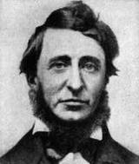
Henry David Thoreau (1817 – 1862)
Unjust Laws…obey them, amend them, or transgress them

Slide 7
Under a government which imprisons any unjustly, the true place for a just man is also a prison.… where the State places those who are not with her, but against her,– the only house in a slave State in which a free man can abide with honor.… If a thousand men were not to pay their tax bills this year, that would not be a violent and bloody measure, as it would be to pay them, and enable the State to commit violence and shed innocent blood. This is, in fact, the definition of a peaceable revolution, if any such is possible. - H.D. Thoreau

Slide 8
That government is best which governs least;” Carried out, it finally amounts to this, which I also believe,—“That government is best which governs not at all;”
Thoreau

Slide 9
"I am too high-born to be propertied, To be a secondary at control, Or useful serving-man and instrument To any sovereign state throughout the world." -H.D. Thoreau (On Civil Disobedience)

Slide 10
Gandhi and Civil Disobedience Movement
1882 British Salt Act
Salt Satyagraha
Dharasana Satyagraha
Declaration of Independence, or Purna Swaraj, on 26 January 1930

Slide 11
American journalist Webb Miller was an eye-witness to the beating of satyagrahis with steel tipped lathis. His report attracted international attention:
Not one of the marchers even raised an arm to fend off the blows. They went down like ten-pins. From where I stood I heard the sickening whacks of the clubs on unprotected skulls. The waiting crowd of watchers groaned and sucked in their breaths in sympathetic pain at every blow.
Those struck down fell sprawling, unconscious or writhing in pain with fractured skulls or broken shoulders. In two or three minutes the ground was quilted with bodies. Great patches of blood widened on their white clothes. The survivors without breaking ranks silently and doggedly marched on until struck down. When every one of the first column was knocked down stretcher bearers rushed up unmolested by the police and carried off the injured to a thatched hut which had been arranged as a temporary hospital.
At times the spectacle of unresisting men being methodically bashed into a bloody pulp sickened me so much I had to turn away....I felt an indefinable sense of helpless rage and loathing, almost as much against the men who were submitting unresistingly to being beaten as against the police wielding the clubs...
Bodies toppled over in threes and fours, bleeding from great gashes on their scalps. Group after group walked forward, sat down, and submitted to being beaten into insensibility without raising an arm to fend off the blows. Finally the police became enraged by the non-resistance....They commenced savagely kicking the seated men in the abdomen and testicles. The injured men writhed and squealed in agony, which seemed to inflame the fury of the police....The police then began dragging the sitting men by the arms or feet, sometimes for a hundred yards, and throwing them into ditches.^{[7][8]}
http://en.wikipedia.org/wiki/Dharasana_Satyagraha

Slide 12
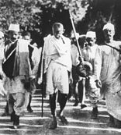
Gandhi’s Salt March From Sabarmati To Dandi
Mar 12, 1930

Slide 13
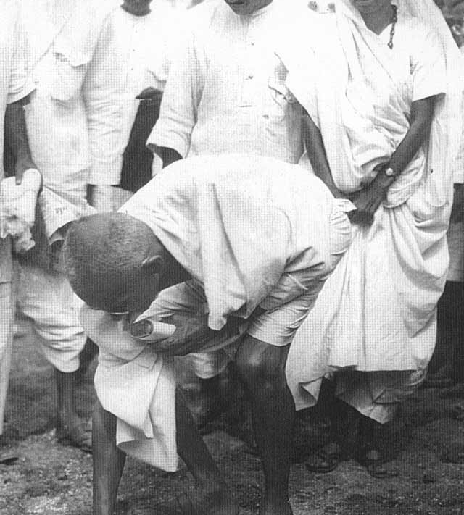
At Dandi (April 5, 1930)
Gandhi picking up a grain of salt at the end of his march

Slide 14
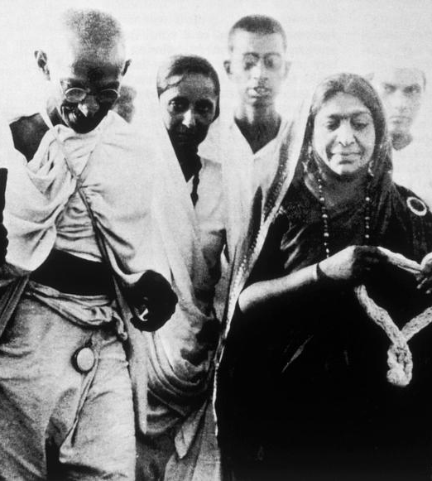
Mahatma Gandhi and Sarojini Naidu
Dandi- march

Slide 15
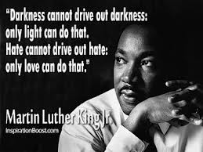

Slide 16
Civil Rights Movement of America
Martin Luther King Junior
NAACP
Civil Rights act of 1964 and the Voting Rights Act of 1965.
Immigration and Nationality Services Act of 1965
Fair Housing Act of 1968

Slide 17
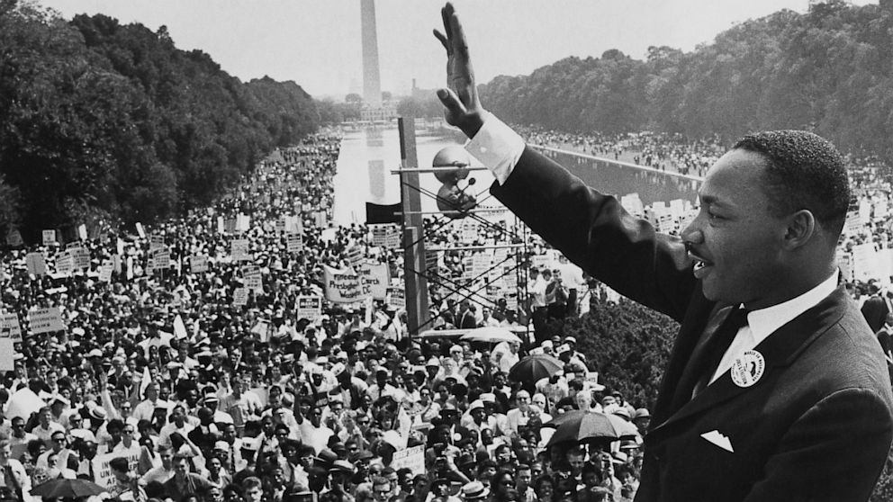
Martin Luther King Jr.
I have a Dream – 1963
Nobel Peace Prize in 1964

Slide 18
I have a dream
But there is something that I must say to my people, who stand on the warm threshold which leads into the palace of justice: In the process of gaining our rightful place, we must not be guilty of wrongful deeds. Let us not seek to satisfy our thirst for freedom by drinking from the cup of bitterness and hatred. We must forever conduct our struggle on the high plane of dignity and discipline. We must not allow our creative protest to degenerate into physical violence. Again and again, we must rise to the majestic heights of meeting physical force with soul force.
Source: www.historylearningsite.co.uk › Civil Rights in America

Slide 19
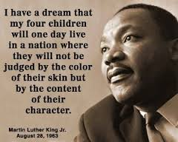

Slide 20
Martin Luther king on Non-Violence
“Nonviolence means avoiding not only external physical violence but also internal violence of spirit. You not only refuse to shoot a man, but you refuse to hate him.”
“The aftermath of nonviolence is the creation of the beloved community, while the aftermath of violence is tragic bitterness.”
“There is within human nature something that can respond to goodness.”
- Martin Luther King, Jr.

Slide 21
Nelson Rolihlahla Mandela
First Black President of SA in 1994
Champion for Peace and Social justice
Leader of Antiapartheid movement in SA
“[I]t would be wrong and unrealistic for African leaders to continue preaching peace and nonviolence at a time when the government met our peaceful demands with force. It was only when all else had failed, when all channels of peaceful protest had been barred to us, that the decision was made to embark on violent forms of political struggle.”
http://mikepylewriter.com/nelson-mandelas-contributions-to-worldwide-equality/

Slide 22
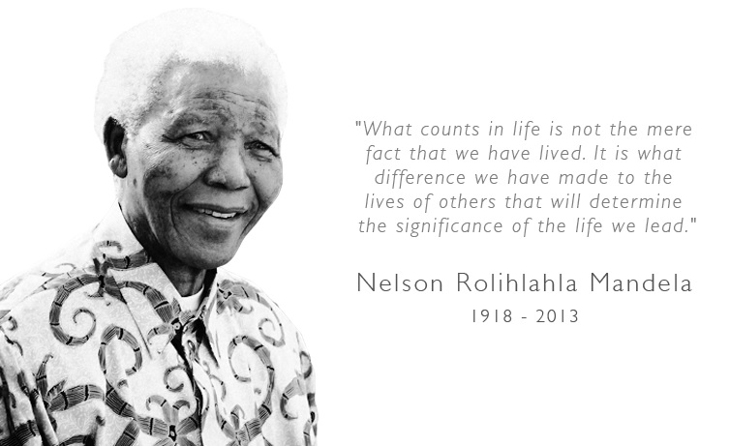

Slide 23
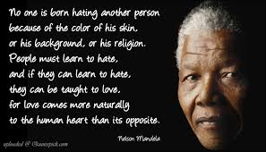

Slide 24
Nelson Mandela and Civil Rights Movement in SA
“I have walked that long road to freedom. I have tried not to falter; I have made missteps along the way. But I have discovered the secret that after climbing a great hill, one only finds that there are many more hills to climb…But I can only rest for a moment, for with freedom come responsibilities, and I dare not linger, for my long walk is not ended.” – Mandela
http://www.goodreads.com/quotes/25448-i-have-walked-that-long-road-to-freedom-i-have

Slide 25
Begun in 2007, The Elders is a group of renowned and independent world leaders working publicly and behind the scenes to “…support courage where there is fear, foster agreement where there is conflict, and inspire hope where there is despair.”
Awarded Nobel Peace prize in 1993

Slide 26
Civil Disobedience in modern times
Anna Hazare’s movement against corruption
Occupy Wall Street

Slide 27
Anna Hazare and Jan Lokpal Bill
A look at the salient features of Jan Lokpal Bill: 1. An institution called LOKPAL at the centre and LOKAYUKTA in each state will be set up 2. Like Supreme Court and Election Commission, they will be completely independent of the governments. No minister or bureaucrat will be able to influence their investigations. 3. Cases against corrupt people will not linger on for years anymore: Investigations in any case will have to be completed in one year. Trial should be completed in next one year so that the corrupt politician, officer or judge is sent to jail within two years. 4. The loss that a corrupt person caused to the government will be recovered at the time of conviction. 5. How will it help a common citizen: If any work of any citizen is not done in prescribed time in any government office, Lokpal will impose financial penalty on guilty officers, which will be given as compensation to the complainant.

Slide 28
6. So, you could approach Lokpal if your ration card or passport or voter card is not being made or if police is not registering your case or any other work is not being done in prescribed time. Lokpal will have to get it done in a month's time. You could also report any case of corruption to Lokpal like ration being siphoned off, poor quality roads been constructed or panchayat funds being siphoned off. Lokpal will have to complete its investigations in a year, trial will be over in next one year and the guilty will go to jail within two years. 7. But won't the government appoint corrupt and weak people as Lokpal members? That won't be possible because its members will be selected by judges, citizens and constitutional authorities and not by politicians, through a completely transparent and participatory process. 8. What if some officer in Lokpal becomes corrupt? The entire functioning of Lokpal/ Lokayukta will be completely transparent. Any complaint against any officer of Lokpal shall be investigated and the officer dismissed within two months. 9. What will happen to existing anti-corruption agencies? CVC, departmental vigilance and anti-corruption branch of CBI will be merged into Lokpal. Lokpal will have complete powers and machinery to independently investigate and prosecute any officer, judge or politician. 10. It will be the duty of the Lokpal to provide protection to those who are being victimized for raising their voice against corruption.
Source: knowledge.icsi.edu/DisplayDoc.aspx?HappeningID=29‎

Slide 29
Occupy Wall Street
A protest movement that began on September 17, 2011, in Zuccotti Park, located in New York City's Wall Street financial district.

Slide 30
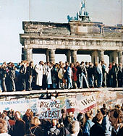
In 1989, East Germans used civil disobedience to break the Berlin Wall in order to unite a divided Germany

Slide 31
Three Rules of Discipline and Eight Points for Attention
A military doctrine that was issued in 1928 by Mao Zedong and his associates for the Chinese Red Army
The three rules
prompt obedience to orders,
no confiscation of peasant property, and
prompt delivery directly to authorities of all items confiscated from landlords.

Slide 32
The eight points
Be polite when speaking
Be honest when buying and selling
Return all borrowed articles
Pay compensation for everything damaged
Do not hit or swear at others
Do not damage crops
Do not harass females
Do not mistreat prisoners

Slide 33
How do I integrate my vow of non-violence in my daily life, while I am faced with so much violence in our society? .... during struggle, What tools can I look to so that my vow becomes a way of Being?
What does nonviolence in thought and speech mean in everyday situations?

Slide 34
